Slide 1

Data 606 Capstone Project Analysis of Telecom Churn Data
Laxmi Prasanna Chennadi
(jg55734)

Slide 2
Introduction:
Current dataset is Telecom churn data which includes various parameters that effect churn.
Definition: The number of Customers leaving the current company and moving to another is known as CHURN in telecommunication .
Dataset comprises of 21 columns, which include State, account length, area code, phone number, international plan, voice mail plan, number of voicemail messages, total day minutes, total day calls, day charge, evening minutes, eve calls, evening charge, night minutes, night charge, international minutes, intl calls, intl charge, customer service calls, churn.
Source: https://www.kaggle.com/becksddf/churn-in-telecoms-dataset

Slide 3
Problem Statement:
The main agenda is to identify possible customers that might churn to other telecom network.
To analyze the factors influencing churn rate.
To build classification and regression models that predict churn.
Apply other machine learning algorithms and evaluate accuracy, performance of these models.
To check which model suits best for the business.

Slide 4
Methodology:
Data Preprocessing
Exploratory Data Analysis
Visualizations of analyzed data.
Building Regression, Classification Models and other Machine Learning Algorithms.
KNN
PCA
Bagging and Boosting
Tuning Parameters and choose best fit algorithm for business purpose.

Slide 5
Exploratory Data Analysis:
Performed Data cleaning and removed null values
Analyzed Target column and rate of churn is 14.49%, which means data is imbalanced.
Examined Correlation between columns.
Factors affecting churn are:
Day Charge
Customer Service Calls
International plan Customers
Later, Outliers are detected and clipped for better analysis.

Slide 6
Model Building:
Used pd.get_dummies to covert the categorical(yes/no) column- international plan and voicemail plan-to numerical(0/1).
Feature Scaling of training data using Min-Max scaling to normalize data.
from sklearn.preprocessing import MinMaxScaler
Data set is split to train set and test set
from sklearn.model_selection import train_test_split
Since it is a classification problem,
Logistic Regression,
K-nearest Neighbors,
Random Forest Classifiers are built.

Slide 7
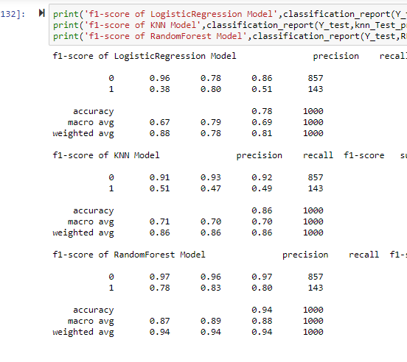
Comparing Accuracy of Models:

Slide 8
K-clustering + PCA+ Random Forest Classifier:
Unique identity columns are clustered.
PCA is used to remove columns with multicollinearity.
New data frame is created with two PCA components to churn + international plan + voicemail plan + clusters.
Applied Random Forest classifier to obtain better results but over fitting is observed.

Slide 9
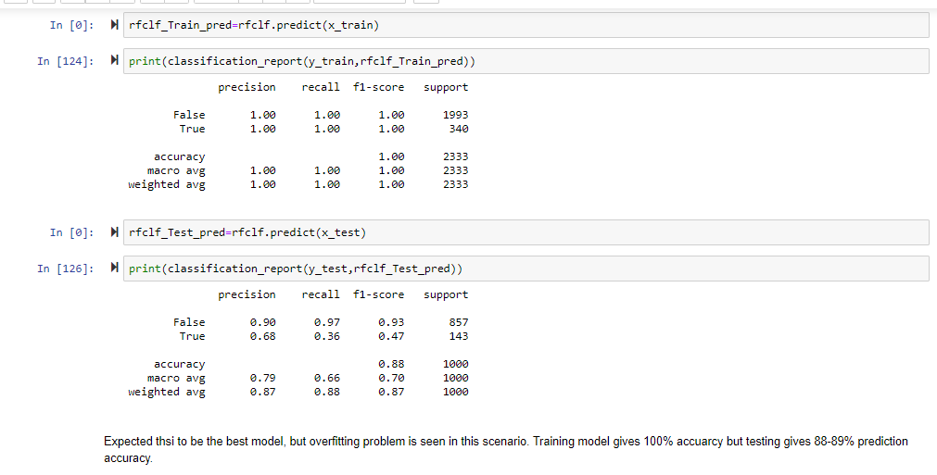

Slide 10
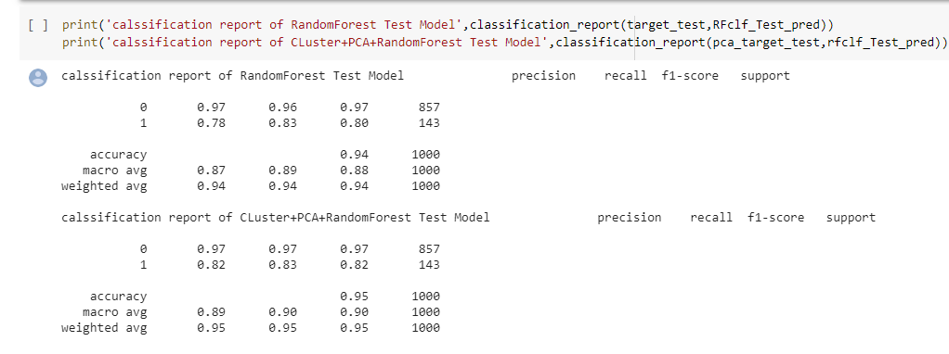
Feature Engineering:
Overfitting is observed due to high variance in data.
To reduce variance, PCA is applied with feature extraction.
New data frame is created with 15 new PCA components to churn + international plan + voicemail plan + clusters.
Random Forest + PCA + Cluster Classifier records 1% increase when compared to simple Random Forest classifier model.

Slide 11
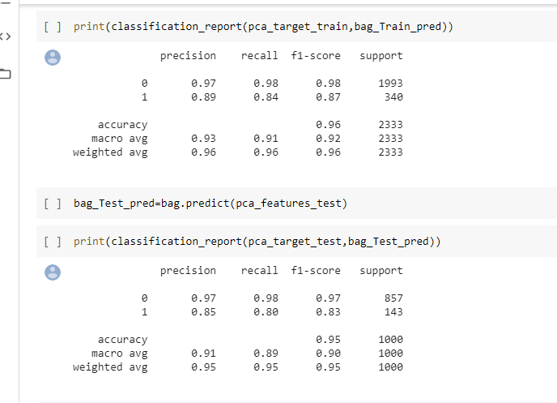
Bagging:
Bagging is ensemble method used to reduce variance.
Accuracy on train set is 96% and on validation set is 95%, same as Random Forest Classifier.

Slide 12
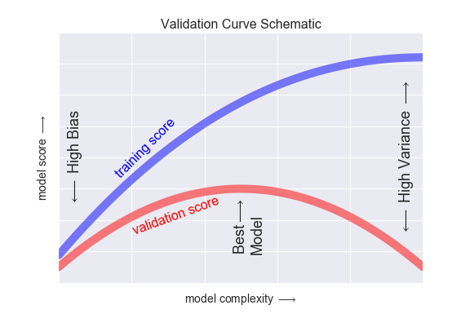
Evaluating Performance of the Model:
Performance of the model is evaluated by using validation_curve
Validation curve has 2 important inputs. They are:
Model Complexity.
Number of Training Data points.
For low model complexity the training data is under-fit.
For very high model complexity the training data is over-fit.
At intermediate point, the validation curve has a maximum.

Slide 13
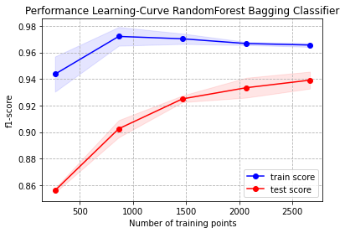
Learning Curve:
Plot of training/validation score with respect to size of training data set is know as “Learning Curve”.
Learning curve converge at particular score as the number of training samples grows
From plot we can analyze that model is at its best and further increase in training data points does not improve the model.

Slide 14
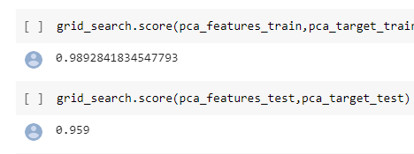
Grid Search:
In order to tune the hyper-parameters and to improve the model performance, I have applied Grid-Search.
Accuracy rate is observed as 99% on training set and 96% in test set
Score has increased further by 1% more when compared to Bagging classifier.

Slide 15
Lessons Learnt:
Explored and applied various classification and regression algorithms.
Dealt with overfitting and its relevance to PCA.
Studied validation curve and factors effecting it.
Feature Engineering.
Learning Curve and how size of training data points effect performance of the model.

Slide 16
Conclusions:
The rate of churn is 14.491%.
Factors affecting CHURN
As day charge increases, rate of churn is also increasing.
Churn is increasing with increase in customer service calls.
Churn rate is high for customers with international plan.
Applied Logistic Regression, K-Nearest Neighbors, Random Forest Classifier, K-clustering, and PCA.
Applied Ensemble method (Bagging) and Grid Search.
Random Forest Classifier is best model fit to the data set.

Slide 17
QUESTIONS??

Slide 18
Thankyou.

